Slide 1
Speech Emotion Recognition
Daniel Dimond
Data Science Capstone Project 2
Springboard

Slide 2
Human Emotion and Machines
The interaction between humans and machines is becoming more and more common.
How we communicate with machines is changing rapidly.
Expanding our tools in one particular way is machine learning emotion detection in human speech.
Why does this matter?
This could be useful for call centers wishing to improve customer service.
Devices that use speech to communicate such as Alexa or Siri.

Slide 3



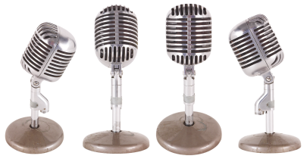
Problem Statement
The purpose of this data science project is to come up with a predictive model for emotion recognition in speech.

Slide 4

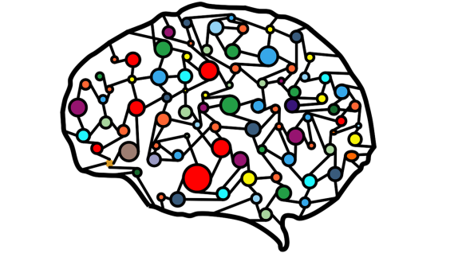



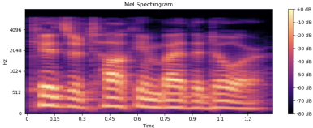
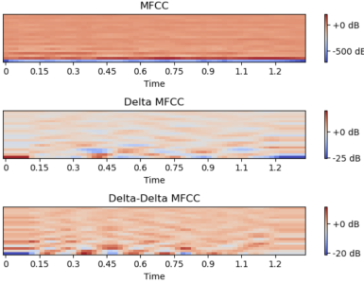
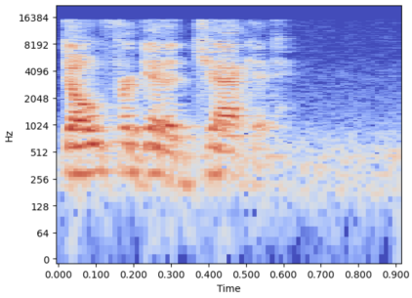
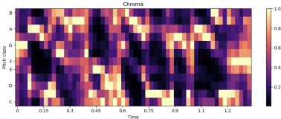

The Approach
Metrics used: mean, max, min, median, standard deviation, skew, and kurtosis
To get to this point, I used Pandas and Librosa to extract features.
Neural Network
mel spectrograph
delta mfcc
Random Forest Classifier
mfcc
This produced about 70 features per sample.
chroma
Neutral
Calm
Happy
Sad
Anger
Disgust
Fearful
Surprised
Several tools were used from Librosa’s library.

Slide 5
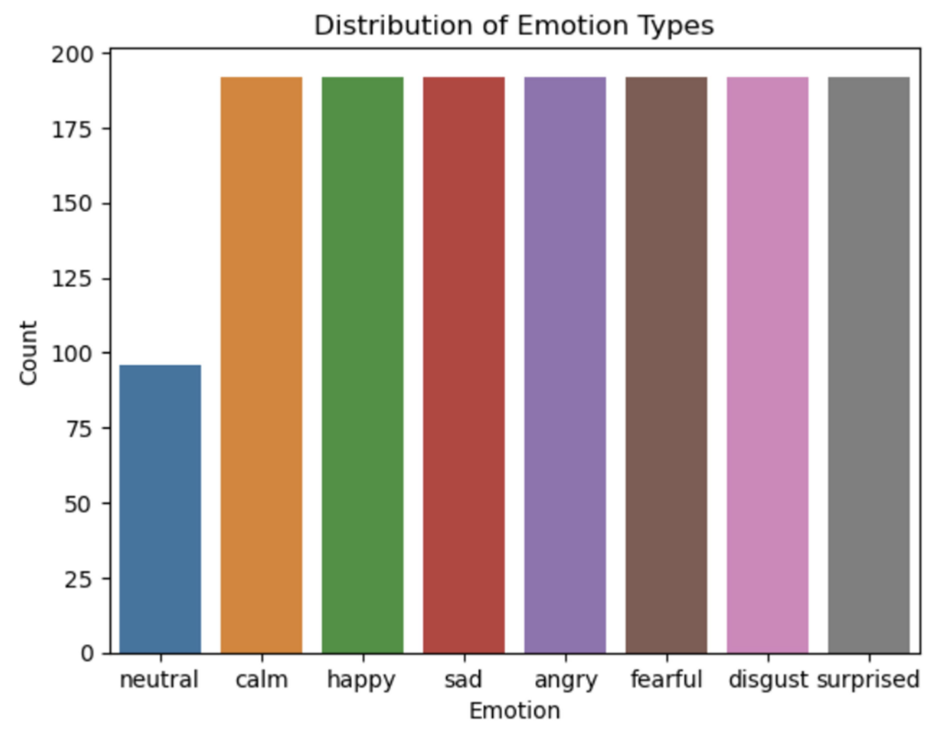
The Dataset
Ryerson Audio-Visual Database of
Emotional Speech and Song (RAVDESS).
24 actors
8 emotions
1440 total samples
Sample rate:
Some Repeat Phrases / Emotions

Slide 6
Results Overview
7 Emotion Classes
4 Emotion Classes
(angry, calm, happy, sad,
fearful, disgust, surprised)
(angry, calm, happy, sad)
Male
Accuracy: 53.57%
Precision: .62
Recall: .54
F1 Score: .54
Female
Accuracy: 52.97%
Precision: .56
Recall: .53
F1 Score: .53
Male
Accuracy: 65.63%
Precision: .68
Recall: .66
F1 Score: .66
Female
Accuracy: 63.54%
Precision: .64
Recall: .64
F1 Score: .62

Slide 7
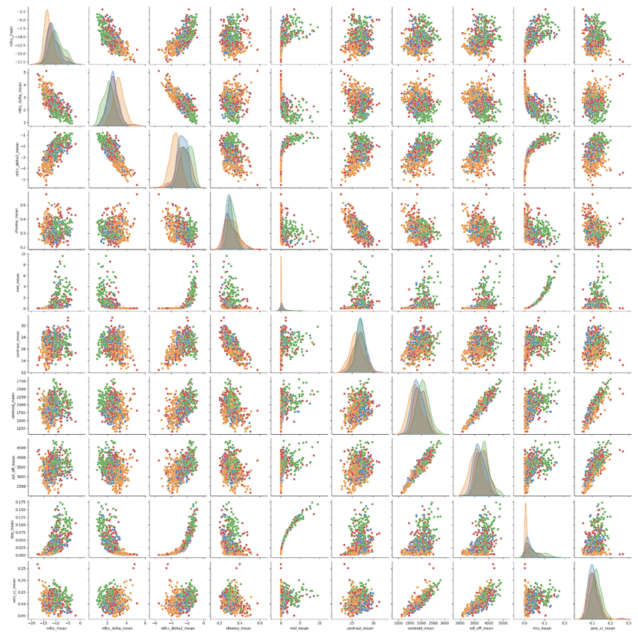
Visualizing
There was a lot of overlap with
each feature.
Needed more tools to
differentiate each emotion.
Used Random Forest Classifier
to provide feature importance.
Used Gradient Boosting as well.

Slide 8
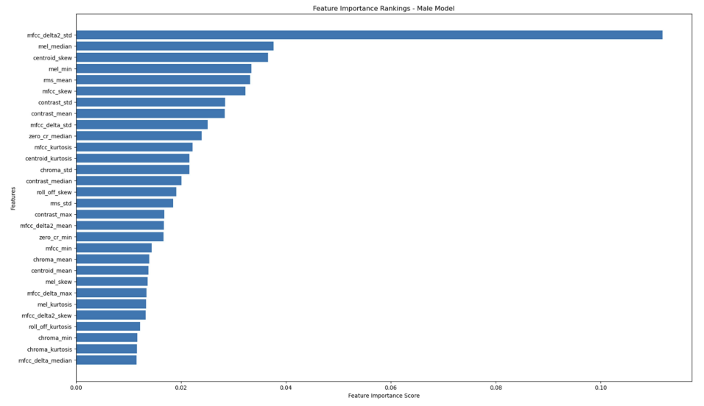
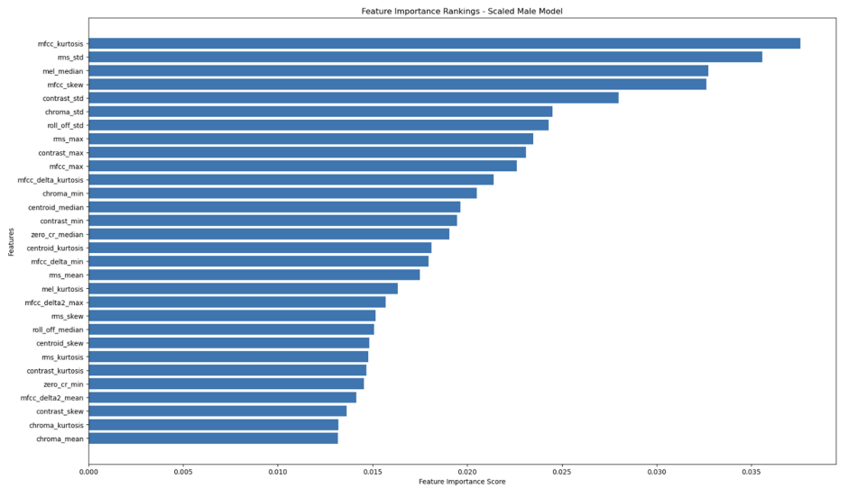
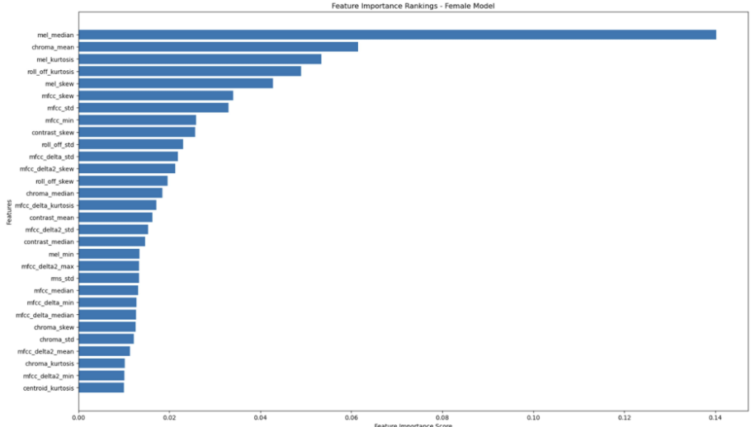
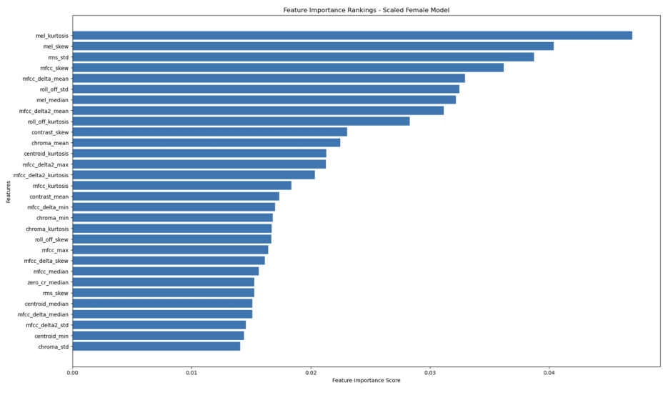
Feature Importance
Random Forest – Male Feature Importance
Gradient Boosting – Male Feature Importance
Random Forest – Female Feature Importance
Gradient Boosting – Female Feature Importance

Slide 9
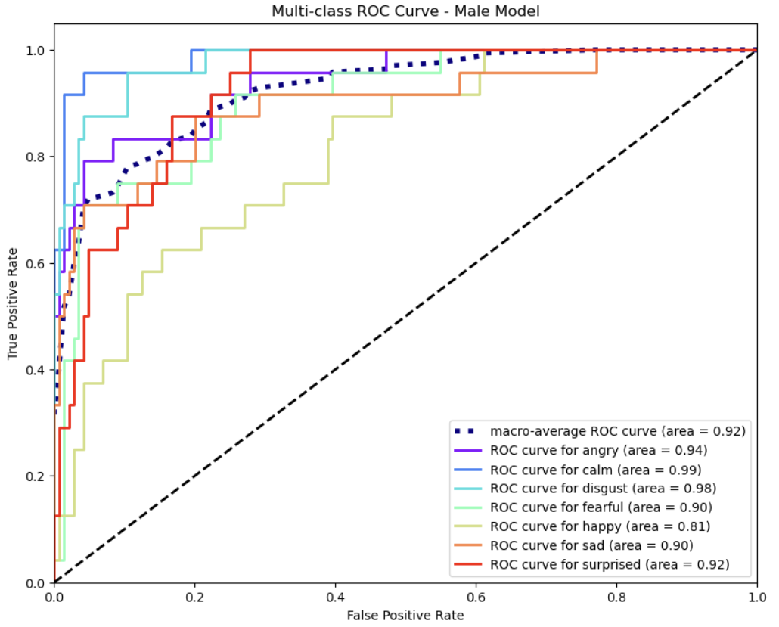
Top Features
Male dataset: mfcc_delta_median, rms_std, mfcc_delta2_max, contrast_median, and chroma_std.
Female dataset: mel_kurtosis, mfcc_skew, rms_std, mel_skew, and roll_off_kurtosis.

Slide 10
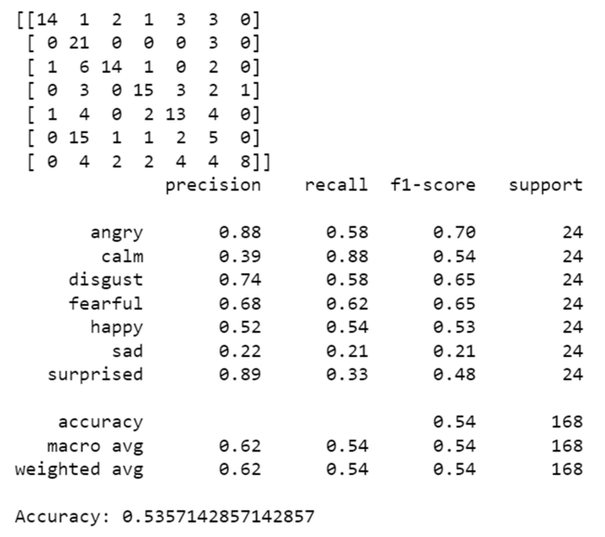
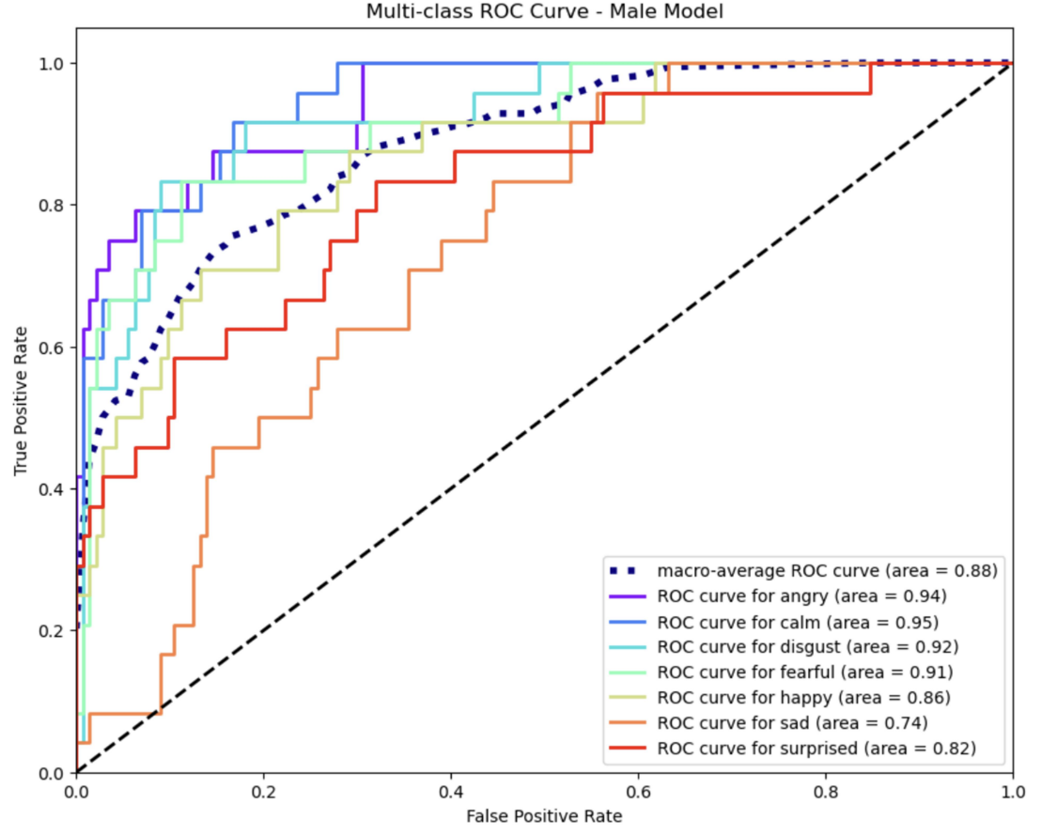
Multi-layer Perceptron Classifier
Male dataset results
Accuracy could use improvement.
ROC curve shows we’re headed in the right direction.

Slide 11
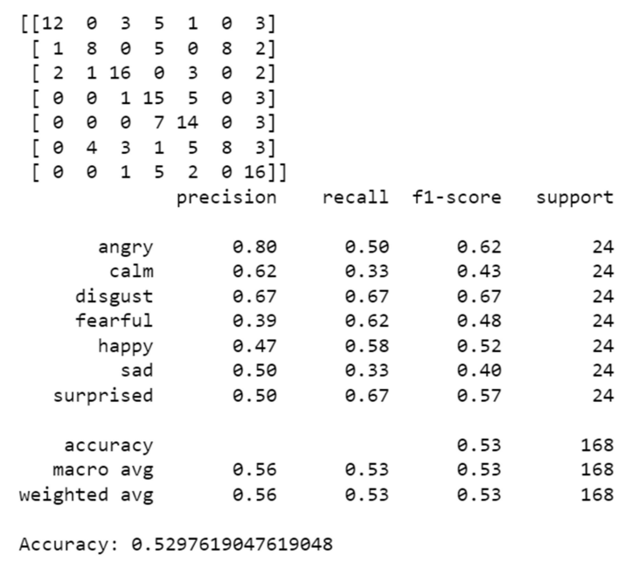
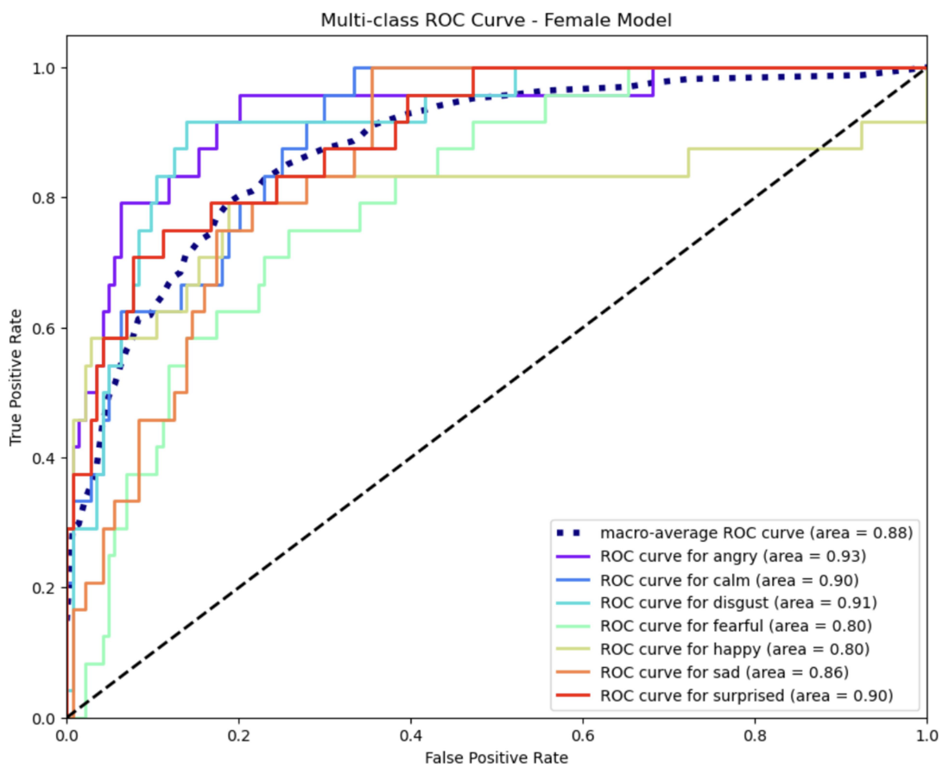
Multi-layer Perceptron Classifier
Female dataset results
More voice emotion data is necessary.
Not a lot of available data currently.

Slide 12
Describe train test split and why it was done with actors separated
Cross validation supported
Randomized search & grid search for hyper parameters

Slide 13
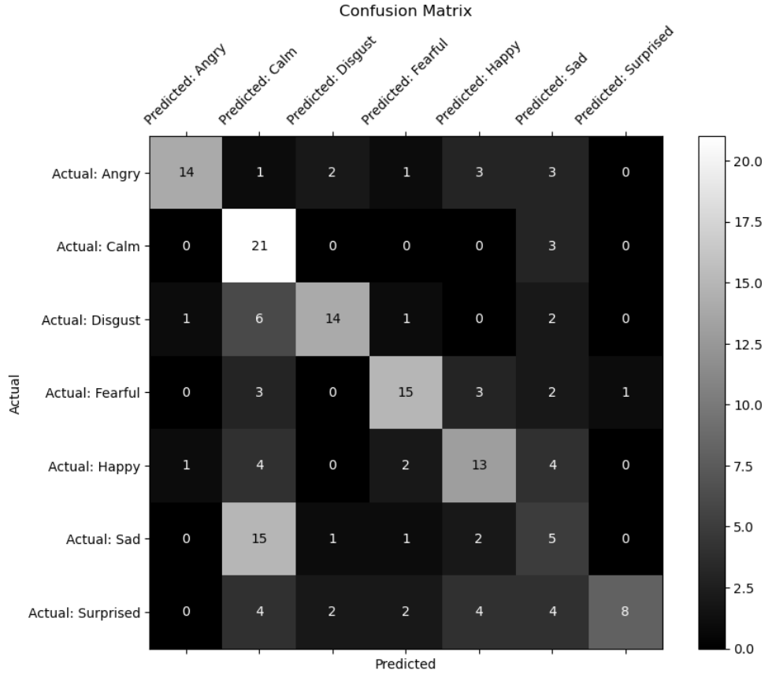
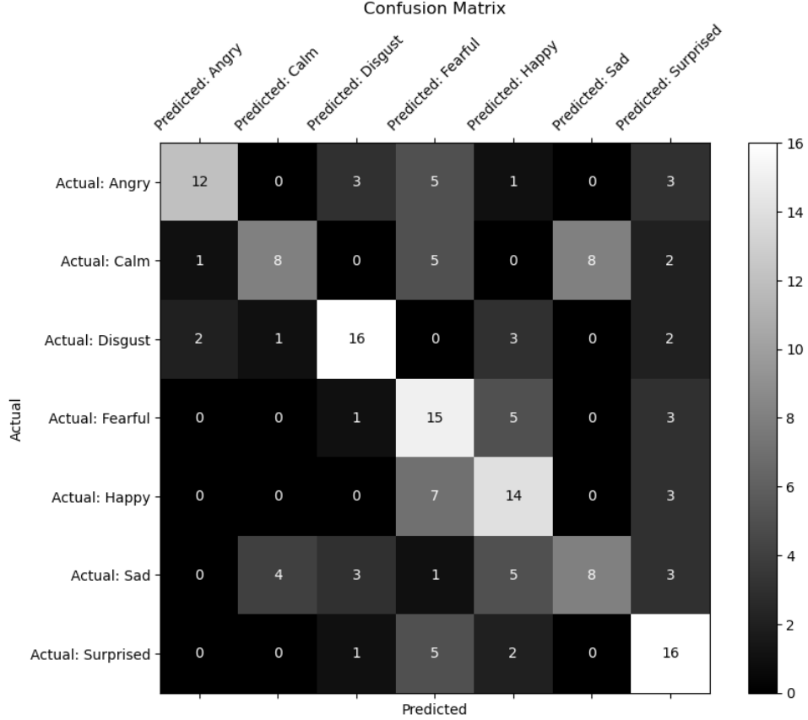
Results
Male dataset
Female dataset
*Neutral was removed due to it’s proximity to Calm

Slide 14
Conclussion
As you can see Sad and Calm were often confused for one another.
More professional audio data will be needed.
Using Librosa to turn an audio problem into a visual one could potentially yield better results.

Slide 15
Thank you!
Academic citation
Livingstone SR, Russo FA (2018) - The Ryerson Audio-Visual Database of Emotional Speech and Song (RAVDESS): A dynamic,
multimodal set of facial and vocal expressions in North American English. PLoS ONE 13(5): e0196391. https://doi.org/10.1371/journal.pone.0196391.
All other attributions
"The Ryerson Audio-Visual Database of Emotional Speech and Song (RAVDESS)" by Livingstone & Russo is licensed under CC BY-NA-SC 4.0.

